Slide 1
Blackboard Developer Platform
REST Technical Deep Dive: Community Developer Portal and REST APIs

Slide 2
Agenda
Welcome, Introductions & Credits
The Blackboard Developer Platform
Community
The Developer Portal
REST APIs Using cURL

Slide 3
Introductions & Credits
Mark Kauffman
Partner Software Engineer
Blackboard Business Development
mark.kauffman@blackboard.com
Scott Hurrey
Code Poet/Senior Technical Writer
Blackboard Developer Experience
scott.hurrey@blackboard.com
Mark O’Neil
Tech. Sherpa/Senior Product Manager Developer Platform
Blackboard Industry and Product Management
mark.oneil@blackboard.com

Slide 4
Statements regarding our product development initiatives, including new products and future product upgrades, updates or enhancements represent our current intentions, but may be modified, delayed or abandoned without prior notice and there is no assurance that such offering, upgrades, updates or functionality will become available unless and until they have been made generally available to our customers.

Slide 5
The Blackboard Developer Platform
A Developer Platform is more than APIs
Community
Tools
Documentation
Sample Code on GitHub
Outreach
Of course APIs are important too…

Slide 6
The Developer Portal
The Developer Portal is about REST API discovery, documentation, and Application delivery
Notes:
Developer.blackboard.com

Slide 7
The Developer Portal
Swagger-based Documentation

Slide 8
The Developer Portal
Application Management

Slide 9
Developer Portal Demo

Slide 10
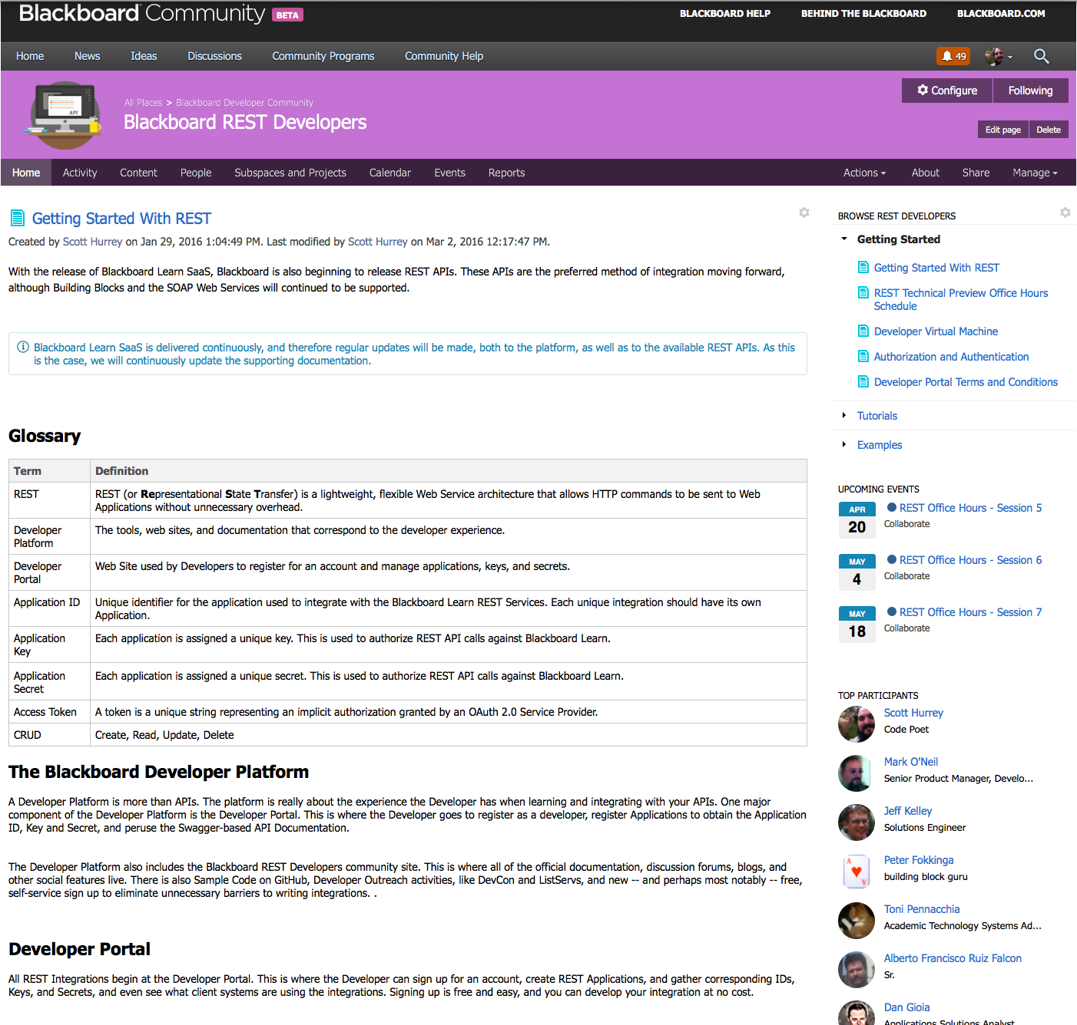
Developer Community
https://community.blackboard.com/community/developers/rest

Slide 11
Application Workflow

Slide 12
Developer Virtual Machine
The Developer Virtual Machine
Vagrant .box image
Uses Virtual Box to host the image
Is available on behind.blackboard.com
If you have registered it is also available via the community site

Slide 13
Learn REST API Integration Tool
The REST API Integration tool is a Learn Building Block that provides:
In Learn creation of REST Integration access
Requires the REST Application ID
Requires a Learn User with the appropriate level of entitlements to run the Application
Secure OAuth2 authorization of REST Application access to your Learn system.

Slide 14
REST API Integration Tool Demo

Slide 15
REST OAuth 2.0 Authorization & API Call
The REST Framework utilizes Application-provided OAuth 2.0 Keys, Secrets, and Access Tokens for authorized REST Application access to Learn.

Slide 16
Authentication and Making a REST Call Demo

Slide 17
Sample Code
http://bit.ly/LearnRestAPIexamples
All Sample Code demonstrates how to:
authenticate,
use tokens, and
access each available object and display data.
All Sample Code supported by:
README.md files
Code Walkthrough Documentation

Slide 18
Code Review
Available Languages
Java
Python
PHP
Ruby
C#
Node.JS
Requests? developers@blackboard.com

